Slide 1
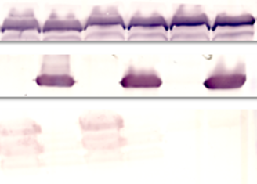
- + - + - +
0.1% arabinose
GroEL
LacI
PspA
χ12358(pYA4088)
χ9241(pYA4088)
χ 9241(pYA3493)
Supplementary figure 1 The expression of rPspA and lacI.
The western blots showed the express of rPspA in strains χ12358 (pYA4088), χ9241 (pYA4088) and χ9241 (pYA3493). The strains were cultured in LB broth with (+) or without (-) 0.1% arabinose overnight at 37℃. Equal numbers of cells from each strain were pelleted, suspended in protein loading buffer and boiled. Equal volumes were separated on SDS-PAGE in triplicate gels. Each gel was transferred to nitrocellulose and reacted with polyclonal antibody specific for rPspA, LacI and GroEL, respectively. GroEl was used as a standardization marker.

